Slide 1

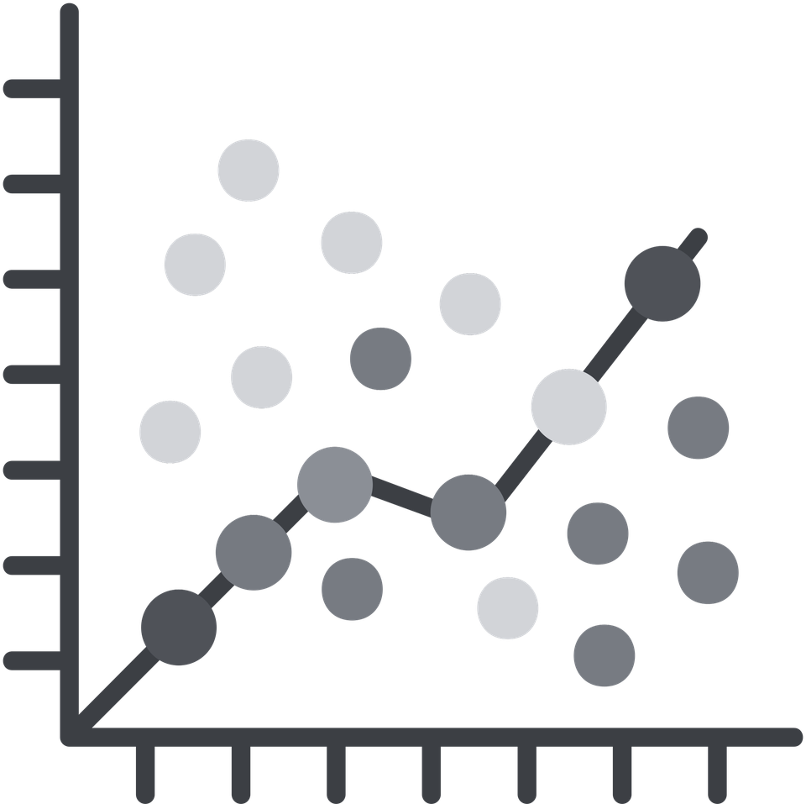
The Crystal Ball
Simple Linear Regression
Moving from 'What Happened' to 'What Will Happen'
The Power of Linear Forecasting
WEEK 7
01 / 30

Slide 2
THE PREDICTIVE LEAP
The Shift: From Past to Future
Descriptive (Past)
Predictive (Future)
What happened?
What will happen?
Reports on history
Models the trajectory
The Rearview Mirror
The Crystal Ball
Certainty, it already occurred
Probability, a calculated bet
02 / 30

Slide 3
THE PREDICTIVE LEAP
What Is Linear Regression?
A statistical method that models the relationship between two variables
Y (Dependent) = the outcome we want to predict. e.g. Total Sales.
X (Independent) = the predictor we can control. e.g. Marketing Spend.
Tells us exactly how much Y changes for every 1-unit increase in X
For every $1 added to the marketing budget, sales increase by how much?
03 / 30

Slide 4
VARIABLES
Dependent vs. Independent Variables
Dependent Variable (Y)
Independent Variable (X)
The Outcome the 'Effect'
The Predictor the 'Cause'
What we want to predict
What we can control or observe
e.g. Revenue, Churn, Profit
e.g. Ad spend, price, temperature
Sits on the vertical axis
Sits on the horizontal axis
04 / 30

Slide 5
VISUALIZE FIRST
The Scatter Plot: Always Look First
Before any calculation: plot X against Y in a scatter plot
Look for a cloud of dots that naturally forms a diagonal line
If the dots are a random mess, a linear model is the wrong tool
Upward slope = positive relationship. Downward slope = negative.
Tight cluster around a line = strong signal. Wide spread = weak signal.
05 / 30

Slide 6

SECTION 2
The Geometry
of a Prediction
How the math draws the line through the dots
06 / 30

Slide 7
THE EQUATION
The Regression Equation: Y = a + bX
a (Intercept): the value of Y when X equals zero
e.g. Sales if we spend $0 on advertising base demand
b (Slope): how much Y changes for every 1-unit increase in X
e.g. For every $1,000 extra in ad spend, sales increase by $4,200
The equation is a recipe: plug in any X to get the predicted Y
Y = 50 + 2X means: start at 50, add 2 for every unit of X
07 / 30

Slide 8
THE LINE
The Line of Best Fit
The computer tests thousands of possible lines through the data
It selects the line that minimizes the Sum of Squared Errors (SSE)
SSE = the total area of all the gaps between the line and the actual dots
The chosen line is the most honest, it is as wrong as it can possibly be least
No line is perfect. The best line is the one that is wrong the least.
08 / 30

Slide 9
MODEL QUALITY
Correlation (r) vs. Determination (R²)
r — Correlation
R² — Coefficient of Determination
Direction and strength of relationship
How much of Y your model explains
Scale: -1 to +1
Scale: 0 to 1 (or 0% to 100%)
+1 = perfect positive link
R² = 0.90 = powerhouse model
-1 = perfect negative link
R² = 0.10 = nearly useless predictor
09 / 30

Slide 10
R² EXPLAINED
R² = 0.75
75% of sales variation is explained by TV ad spend
The other 25% is driven by things not in the model: weather, competitors, luck, seasonality.
An R² of 0.75 means 75% of the variation in our sales is explained by our TV ads. The other 25% is caused by things we aren't measuring (weather, competitors, luck).
10 / 30

Slide 11
SLOPE DIRECTION
Positive vs. Negative Relationships
Positive Slope
Negative Slope
X goes up, Y goes up
X goes up, Y goes down
Ad spend vs. Sales
Price vs. Quantity sold
Temperature vs. Ice cream sold
Distance vs. Delivery satisfaction
Accelerate X to grow Y
Reduce X to protect Y
11 / 30

Slide 12
SECTION 2 • THE INTERCEPT
The Intercept in Reality
Coffee Sales = 50 + 2 * Temperature
The '50' = base demand. You sell 50 coffees even on a 0-degree day.
The intercept is what you have before any predictor kicks in
In business: the intercept often represents fixed behavior, loyal customers, habit
Never ignore the intercept. It tells you where the business starts.
12 / 30

Slide 13
CASE STUDY
Guess the R²
Rank these three scatter plots from highest R² to lowest.
[R²=?]
[R²=?]
[R²=?]
Plot A
Plot B
Plot C
Dots form a tight
diagonal line.
Almost no spread
around the line.
Dots form a loose
cloud with a
visible diagonal
tendency.
Dots scattered
completely at
random. No visible
pattern at all.
13 / 30

Slide 14

SECTION 3
The Danger Zones
Where the model breaks down and human judgment takes over
14 / 30

Slide 15
PREDICTION RANGE
Interpolation vs. Extrapolation
Interpolation (Safe)
Extrapolation (Dangerous)
Predicting inside your data range
Predicting outside your data range
X values you have seen before
X values never observed
The model has evidence here
Model is guessing beyond its knowledge
Relatively reliable
Small errors in slope = large errors in prediction
15 / 30

Slide 16
THE ERRORS
Residuals: The Errors
Residual = Actual Value - Predicted Value
Every prediction has a residual, the model is never perfectly right
Professional analysts always examine the residuals, not just the line
If errors follow a pattern (get larger over time, cluster in one area), the model is missing something
Random residuals = good model. Patterned residuals = incomplete model.
16 / 30

Slide 17
LEVERAGE POINTS
Outliers & Leverage
One extreme data point can tilt the entire regression line
High leverage point: an outlier far from the average X value
Imagine a single dot at the far right of a scatter plot dragging the line toward it
Always check: does removing this one point dramatically change the line?
If yes, investigate that point before trusting the model
17 / 30

Slide 18
PRECISION
Standard Error of the Estimate
The average size of the prediction errors, the model's margin of mistake
Never say: 'We will sell exactly 500 units next quarter'
Always say: 'We will sell 500 units, plus or minus 20'
A smaller standard error = a more precise model
Presenting a prediction without an error range is false confidence
18 / 30

Slide 19
EXCEL
Regression in Excel: The Trendline
Create a scatter plot. Right-click any data point > Add Trendline
Check 'Display Equation on chart' and 'Display R-squared value'
The equation appears directly on the chart, your model is now visible
Select 'Linear' for simple regression. Other options for curved data.
This is the fastest way to turn a chart into a mathematical prediction machine
19 / 30

Slide 20
EXCEL PRO MODE
Full Regression Report: Analysis ToolPak
Data > Data Analysis > Regression
Input Y Range: your outcome column. Input X Range: your predictor column.
Output: slope, intercept, R², standard error, and p-values in one table
This is the professional-grade output you present to stakeholders
Check 'Residuals' to get the individual errors for every data point
20 / 30

Slide 21
SIGNIFICANCE
P-Values: The BS Detector
The p-value asks: is this relationship real, or just a coincidence?
P < 0.05: the relationship is statistically significant, it is real
P > 0.05: the relationship might be random luck, don't bet the budget on it
A high R² with a high p-value is a warning, the model fits your sample but may not generalize
Always check the p-value before reporting any regression result to leadership
21 / 30

Slide 22
CASE STUDY & TOOL
Putting It Together
Real Estate Model
FORECAST.LINEAR in Excel
Y = House Price
=FORECAST.LINEAR(new_X, Y_range, X_range)
X = Square Footage
Type any future X value
Strong R² and low p-value
Cell returns the predicted Y instantly
But what about Location?
Change X and prediction updates live
22 / 30

Slide 23

SECTION 4
The Human Element
& Ethics
All models are wrong, but some are useful
23 / 30

Slide 24
CRITICAL THINKING
Causality vs. Correlation
Ice cream sales and drowning incidents both rise in summer
Does eating ice cream cause drowning? No -- the sun causes both.
Statistics find the link. Humans find the logic behind the link.
A regression line proves nothing about cause -- it only describes the pattern
Before acting on a model: always ask what mechanism connects X to Y
24 / 30

Slide 25
MODEL QUALITY
Overfitting: The Perfect Model Trap
If your line passes through every single dot, something is wrong
An overfit model memorizes the noise in the training data
It performs perfectly on past data and catastrophically on new data
A model should capture the trend, not the individual data points
Test: does the model still work on data it has never seen before?
25 / 30

Slide 26
ETHICS
The Ethics of Forecasting
Using regression to set 'unreachable' sales targets for employees
A model that ignores human burnout will eventually fail its own predictions
The people executing the forecast are not variables, they are the system
Forecasts become self-fulfilling or self-defeating depending on how they are communicated
Ethical forecasting: present ranges, not targets. Build in uncertainty.
26 / 30

Slide 27
COMMUNICATION
Talking to Non-Technical Audiences
Don't Say
Do Say
R² = 0.82
Strong evidence, model explains 82% of variation
P-value < 0.001
The relationship is almost certainly real
Slope coefficient = 4.37
Each extra $1k in ads adds ~$4k in sales
Residual standard error = 12.4
Predictions are accurate within +/- 12 units
27 / 30

Slide 28
“
Always ask: 'What else could be causing this?'
An analyst who never asks 'What else?' is just a calculator.
Soft Skill: Skepticism
28 / 30

Slide 29
SUMMARY
What We Covered This Week
Variables: choosing the right X is the most important decision in regression
Y = a + bX: the intercept sets the baseline, the slope tells you the rate of change
R² measures model quality. P-values confirm the relationship is real.
Danger zones: extrapolation, outliers, overfitting, and confusing correlation with causation
29 / 30

Slide 30

Let's Talk.
All models are wrong.
But some are useful.
George Box
Lab: 'Marketing ROI Predictor' prove whether the budget is being spent wisely.
Next week: Multiple Regression.
30 / 30

